Slide 1

Topic:College Event Scheduling
Team Members:
A.Siddu(25MVCSDR0002)
K.Chaithra(25MVCSDR0036)
M.Hareesh(25MVCSDR0045)
R.Siri Chandana(25MVCSDR0071)

Slide 2
COLLEGE EVENT
SCHEDULING
using Backtracking (Design & Analysis of Algorithms)
Hackathon Project | Live demo: CampusSched web app
01
Notes:
Introduce the project: an automated collegiate event scheduling engine powered by backtracking, developed as an algorithm and systems hackathon project with a live web demo.

Slide 3
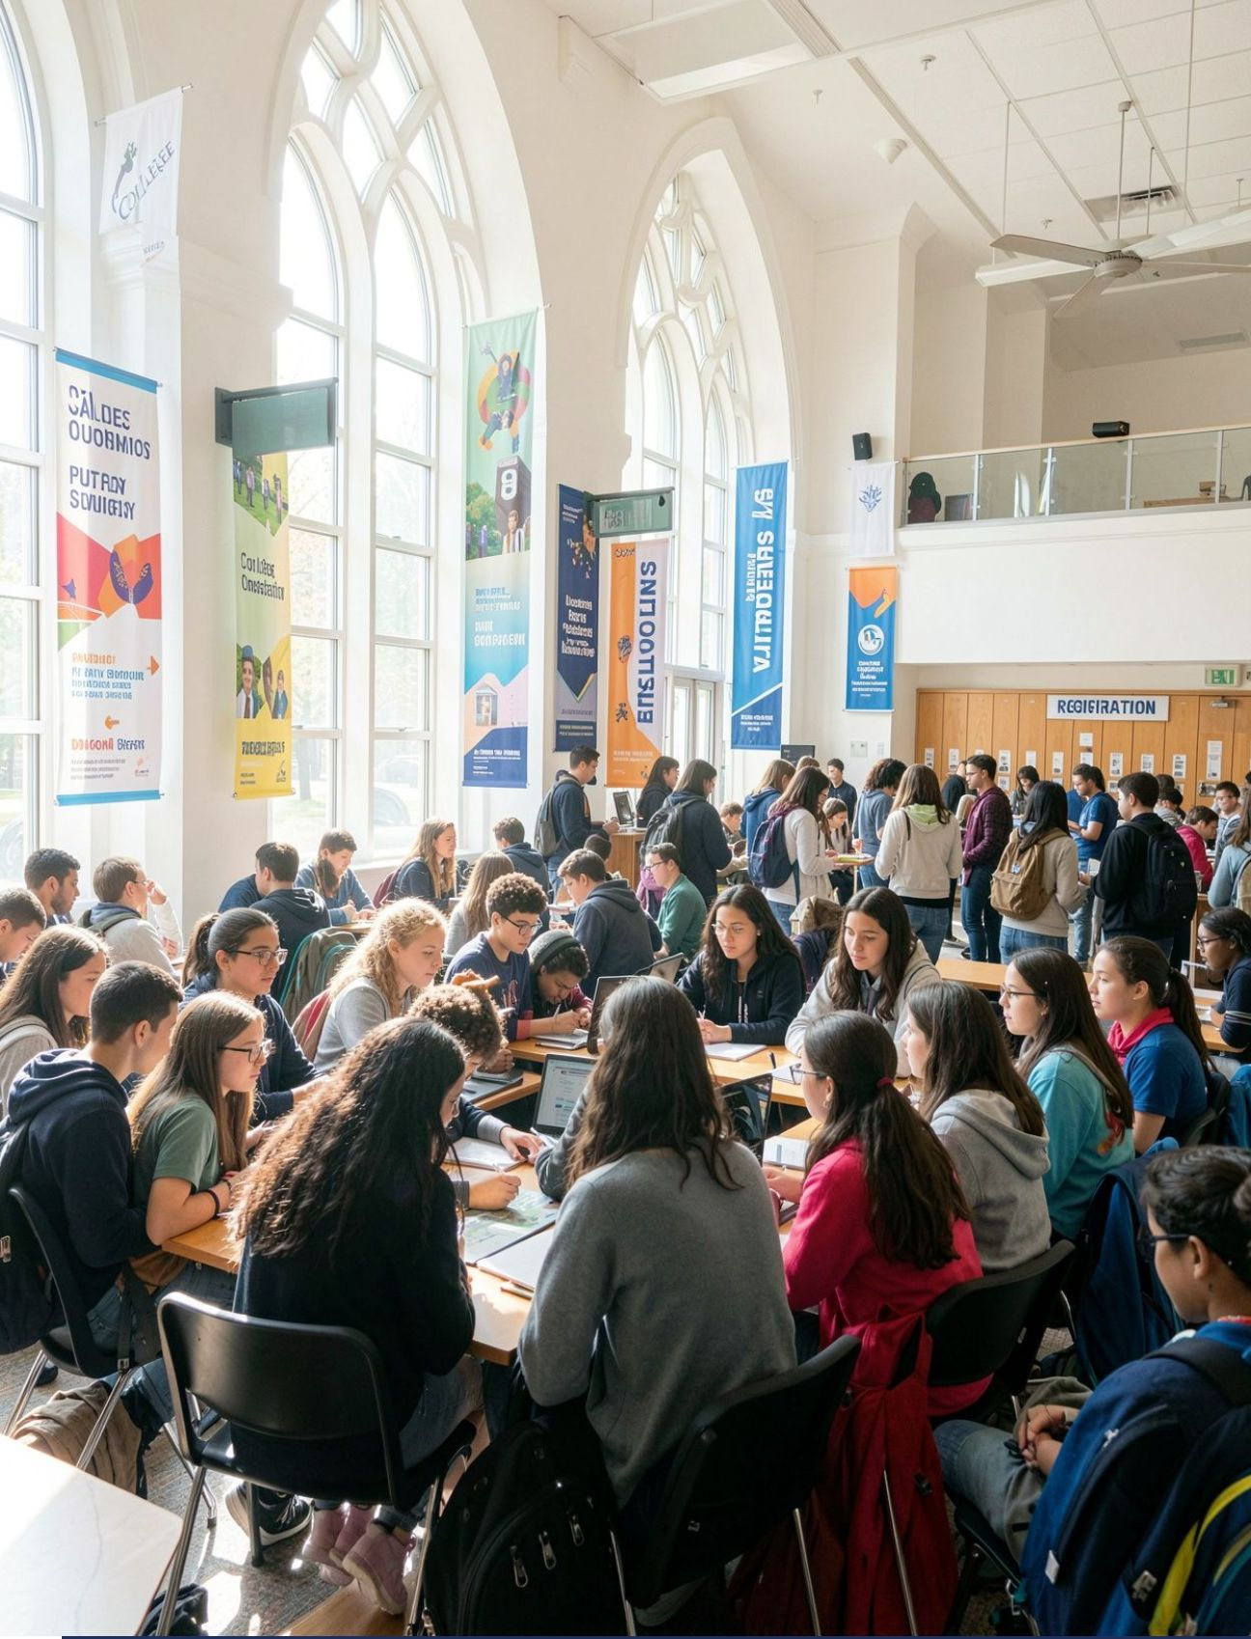
PROBLEM STATEMENT
CAMPUS OPERATIONAL CHALLENGE
1
2
Scale of Events
Finite Capacity
Colleges run many events: seminars, workshops, contests, club meets
Resources are limited: classrooms, seminar halls, labs, equipment
3
4
Manual Failure Modes
Core Objective
Manual scheduling causes clashes in time, rooms and equipment
Goal: build a conflict-free schedule automatically
02
Notes:
Frame the problem: multiple campus events and constrained physical facilities inevitably lead to resource overlap when organized by hand. The algorithm automates clash-free resolution.

Slide 4




CONSTRAINTS TO SATISFY
Room type
Time overlap
Event needs a matching venue: classroom, hall or lab
Two events cannot use the same room at the same hour
Equipment
Time window
Projectors, mics, laptops in use must never exceed stock
Each event must fit inside its allowed start-end window
03
Notes:
Walk through the four hard constraints: matching room venue category, non-overlapping hourly occupancy, equipment ceiling adherence, and containment within strict operating windows.

Slide 5
CORE ALGORITHM
Why backtracking?
Choose a (room, time) per event, check constraints, undo dead ends.
schedule(i):
if i == n: return SOLUTION
for (room, start) in options(event[i]):
if no_room_clash and equipment_ok:
assign(event[i], room, start)
if schedule(i+1): return true
unassign(event[i]) // BACKTRACK
return false
Optimization
MRV heuristic: schedule events with the fewest options first.
Fallback
If no full schedule exists, report the best partial schedule and the unscheduled events.
04
Notes:
Explain the backtracking search procedure: decision formulation, recursive exploration with validation, the MRV heuristic ordering, and graceful partial fallback when constraints cannot be universally satisfied.

Slide 6
COMPLEXITY & RESULTS
O((R·T)^N)
O(N)
FAST
WORST-CASE TIME COMPLEXITY
AUXILIARY SPACE
PRACTICAL BENCHMARK
Worst-case time: R rooms, T slots, n events
Space: recursion depth and assignments
Pruning and MRV keep typical inputs near-instant
The web app shows nodes explored, backtracks and run time for every schedule it builds.
05
Notes:
Discuss theoretical versus empirical performance: exponential theoretical bound tempered by massive constraint pruning and MRV branch reordering, using O(n) call-stack memory.

Slide 7

SUMMARY & OUTLOOK
CONCLUSION &
FUTURE SCOPE
Core Takeaway
Backtracking gives a correct, conflict-free schedule or proves none exists
Future Extensions
Future: multi-day scheduling, event priorities, branch and bound, CSV/PDF export
THANK YOU
06
Notes:
Conclude with the guarantees provided by backtracking search and outline next steps: multi-day scaling, weighted priorities, branch-and-bound optimization, and document exports.

Slide 8
THANK YOU

